Slide 1

Unit 1
Security Basics

Slide 2
CONTENT
INTRODUCTION
SECURITY
ELEMENTS OF INFORMATION SECURITY
SECURITY POLICY
SECURITY TECHNIQUES
STEPS FOR BETTER SECURITY
CATEGORY OF COMPUTER SECURITY
THE OPERATIONAL MODEL OF N/W SECURITY
SECURITY SERVICES
BASIC N/W SECURITY TERMINOLOGY
SECURITY ATTACKS

Slide 3
How safe is your information?
Recent events show that commercial, personal and sensitive information is very hard to keep secure, and some estimates point to 2007 as being the worst year on record for data loss.
As breaches in information security continue to make headline news, it is becoming increasingly clear that technological solutions are not the only answer.
Research conducted in 2007 suggests that at least 80% of data leakages are caused by staff rather than IT systems (source: Financial Times/Forrester Research, Nov-07).
It is clear therefore that Information Security should be viewed as a management function rather than one of IT alone.
Here, the syllabus outline the main management principles designed to help you secure your data, and raise awareness of the issues involved.

Slide 4
1.1 SECURITY
Challenges in Security?
1.Use of computer with internet
2. Software tools are available freely
3. Importance of information
4.Lack of awareness/ignorance/hesitation
PROTECTION
1.Unahorized Access by intentionally or unintentionally.

Slide 5
To protect the operation of any organization
1.Physical Security:- Access control to physical device
E.g:- Pen drive, Hard drive, CD/DVD, Computer,
2. Private Security :- Individual or group
3. Project Security :- Design , Code operation security

Slide 6
Introduction
Information:- Computers, Networks, Internet, Mobile.
Security:-trying to understand how to protect.
The various dangers & pitfalls when we use technology.
The consequences of not setting up the right
Security Policies
Security Framework
Security Technology

Slide 7
Why is Security Required?
Business & different types of transactions r being conducted to a large extent over Internet.
Inadequate or improper security mechanism can bring whole business down or play havoc with people’s lives!
Since Electronic Documents & Messages r now becoming equivalent to proper documents in terms of their legal validity & binding.

Slide 8
Why Study Information Security
Businesses collect mass amounts of data about their customers, employees, and competitors.
Most of this data is stored on computers and transmitted across networks.
If this information should fall into the hands of a competitor, the result could be loss of business, lawsuits and bankruptcy.
Protecting corporate data is no longer an option, it is a requirement.

Slide 9
Information Security
Protecting information and information systems from unauthorized access, use, disclosure, disruption, modification, or destruction.
Background
Throughout history, confidentiality of information has always played a key role in military conflict.
In Past No or little security.

Slide 10
The Need for Security(Current Scenario)
Now a days Importance of data was truly realized.
Financial & Personal data
Therefore various areas in security began to gain prominence.
Typical Examples of Basic Security Mechanism:
Authenticate a User->id, pw
Encode->DB->Not Visible to user who do not have the right permission.
Organization employed their own mechanism.

Slide 11
The Need for Security In Modern Life
Internet took the world by storm.
Technology Improved
Communication Infrastructure became extremely mature.
Newer & newer applications begins to developed for various user demands & need.
Soon peoples realized that basic security measures were not quite enough.

Slide 12
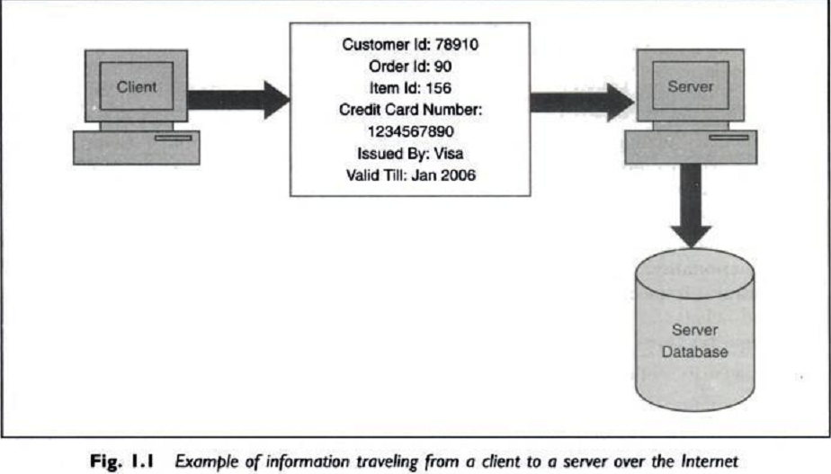
Information traveling from a client to a server over the internet.

Slide 13
Some real time attacks
Russian Attacker Maxim actually manage to intruder into a merchant Internet site & obtained 300,000 credit card numbers from its DB.
He then attempted extortion by demanding protection money($100,000) from the merchant.
The merchant refused to oblige.
Following this, the attacker published about 25,000 of the credit card numbers on the internet!
Some banks reissued all the credit cards at a cost of $20 per card & others forewarned their customers about unusual entries in their statements.

Slide 14
Consequences of Attack
Great Losses-both in terms of finance & goodwill.
Cost of attack $20*300000=$6M
Another Example:-
1999 Swedish hacker broke into Microsoft’s Hotmail Website & created a mirror site.
This allowed anyone to enter any Hotmail user’s email id & read their emails.
2005 survey about the losses that occur due to successful attacks on security. $455,848,000
Next year this figure reduced to $201,757340!

Slide 15
Modern Nature Of Attack
Automating Attacks:-
Traditional Attack: Produce Coins using machinery & Bring them into circulation.
Modern Attack: Steal half a dollar from million accounts in a few minutes time digitally.
2. Privacy Concern:-Every Company are collecting & processing lots of information about us. Without we
realizing when & how it is going to be used.
3. Distance does not matter:- Attack Can be launched from the distance.
E.g:- In 1995, a Russian hacker broke into Citibank’s computer remotely, stealing $12M.
Although the attacker was traced, it was very difficult to get extradited him for the court case.

Slide 16
1.2 ELEMENTS OF INFORMATION SECURITY
This will Help us understand the attacks better & also help us in thinking about the possible solution to tackle it.
Information Security provide services to user.

Slide 17
Principle/Goals Of Security
These r the 4 chief principles of security.
Confidentiality:- Is msg seen by someone else?
Authentication:- Do u trust the sender of msg?
Integrity:- Is the meg changed during transmit?
Non-repudiation:- Can sender refute the msg?
Above principles r related to a particular message.
There r 2 more linked to overall system as a whole.
Access Control:- Who can Access what? [ACL]
Availability:- Information should be available timely.
Notes:
smit

Slide 18
Confidentiality
Confidentiality is the process of preventing disclosure of information to unauthorized individuals or systems.
Examples: Credit card
Confidentiality is necessary, but not sufficient to maintain privacy

Slide 19
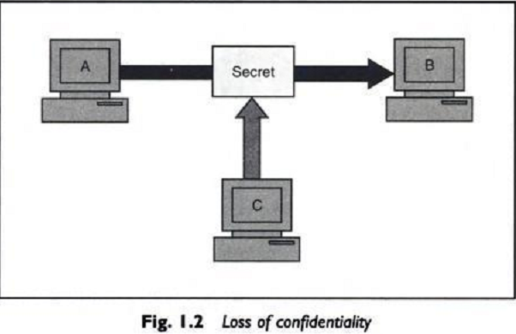
Interception Causes Loss of Message Confidentiality

Slide 20
Authenticity
In computing, e-Business and information security it is necessary to ensure that the data , transactions, communications or documents (electronic or physical)
are genuine (i.e. they have not been forged or fabricated.)
Examples: Passport, Credit card Accounts, academic transcripts

Slide 21
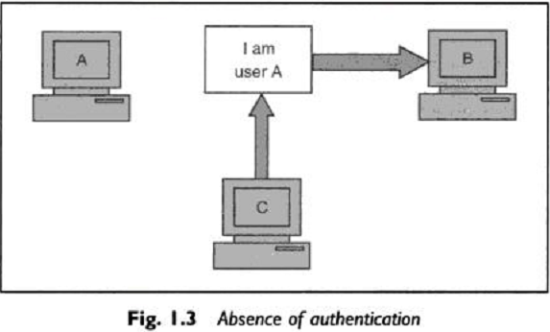
Fabrication is possible in absence of proper authentication

Slide 22
Integrity
Integrity means that data cannot be modified/change without Authorization
Examples: Manual deletion or alteration or creation of important data files, Virus infection, Employee altering their own salary , website vandalism, polling fraud.

Slide 23
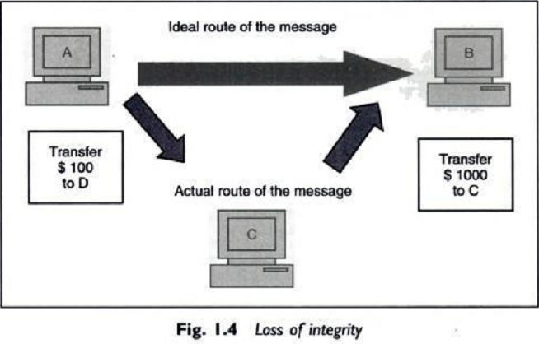
Modification Causes Loss of Message integrity

Slide 24
Non-Repudiation
It is a complex term used to describe the lack of deniability of ownership of a message, piece of data, or Transaction.
Examples: Proof of an ATM transaction, a stock trade, or an
email

Slide 25
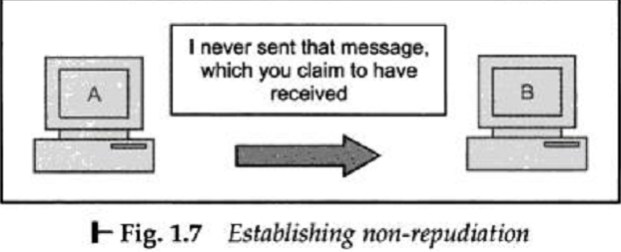
It does not allow the sender of a message to refute the claim of not sending that message

Slide 26
Access Control
Role Management->User Side->Which user can do what.
Rule Management->Resource Side->Which resources r accessible and under what circumstances.
Access Control List is subset of Access Control Matrix.

Slide 27
Availability
For any information/system to serve its purpose,
The information must be accessible & usable when it is needed.
Computing systems used to store and process the information, the security controls used to protect it, and the communication channels used to access it must be functioning correctly.
Examples: Power outages, Hardware failures,
System upgrades and Preventing denial-of-service
attacks

Slide 28
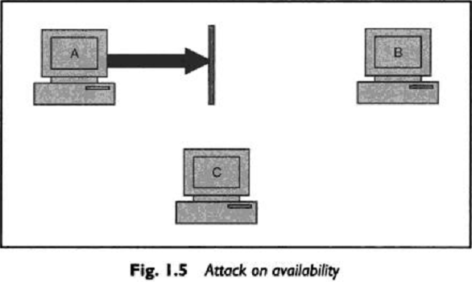
Interruption puts the availability of resources in danger.

Slide 29
1.3 SECURITY POLICY
Risk ->Secure->Action
To control the threats
Providing techniques & measures(e.g Audit)
Developing a secure computing platform to restrict the users to perform the only particular actions that is permitted.
At the same time restrict this user too misuse their rights to use the system.
1. External Approach:- for external attacker
2. Internal Approach:- for inside environmental attack
Notes:
particular

Slide 30
1.4 SECURITY TECHNIQUES
Cryptographic Techniques:- Confidentiality & integrity of data
Authentication Techniques:- to guarantee that communication end-points.
E.g:- who they say the are.
Chain of trust techniques- authentic software
Access Control- privilege & authorization
Capability to detect un-patched known flaws
Back up of data
Anti-virus software
Firewall
IDS/IPS- related to access & misuse
Information Security Awareness- social engineering

Slide 31
1.5 Steps for better Security
Security is the most important aspect of computer world
Following r the steps one should follow:-
Assets:- Decide, Identify, Protect
Risks:- identify threats, attacks, vulnerabilities, exploits, theft
Protection:- find out the solutions
Tools & Technique:- select
Priorities:- decide the order of point 4

Slide 32
1.6 CATEGORY OF COMPUTER SECURITY
Cryptography:- Mathematical “scrambling’’ of data.
Data Security:- Protective measures, keep safe from un- authorized access, privacy, prevent breaches , etc.
Computer Security Model:-
It Depends on computer architecture, specification, security issues, protection mechanism.
Act as a framework for information system security policy.

Slide 33
Continue…
Network Security:-
Protection during transmission,
Policies & provision by Admin,
Authorization & Access Control,
Computer Security Procedure:-
strategies, guideline, policies, standards, specification, regulations & laws.
Security Exploits:-
Vulnerabilities,
Unintended & un-patched flaws in s/w,
Virus, worms & Trojan horses, malwares
Different types of attacks,

Slide 34
Continue…
7. Authentication:- person, computer, program
8. Identity management:- user, device, services
9. Internet policy:- whatsapp, FB, ect..
10. Security Software

Slide 35
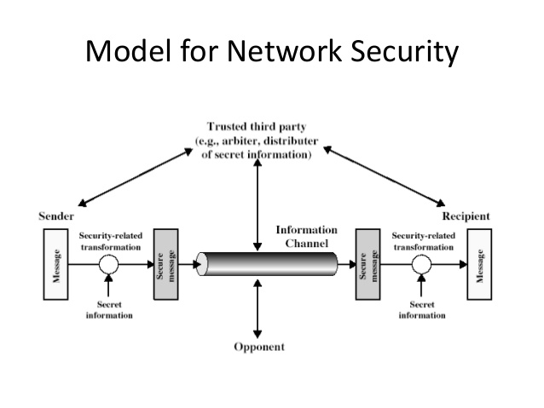
1.7 The Operational Model Of N/W Security

Slide 36
1.8 Basic N/W Security Terminology
NOTE:- Covered through out the syllabus

Slide 37
Security Services
Digital Signature
Password
Encryption
Hash algorithms

Slide 38
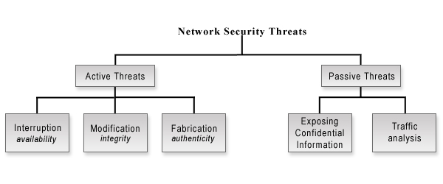
Security Attack

Slide 39
Types of Attack
Attacks: A Technical View
Theoretical Concepts behind this attack.
Inception:- Copying of data & program & listening to N/W Traffic.
Fabrication:-Attacker may add fake records to a database. Creation of illegal objects on the computer system.
Modification:-Attacker modifies Value of DB
Interruption:- Resources became unavailable, lost or unusable. Causing problems to a H/W device, erasing program, Data or OS components.

Slide 40
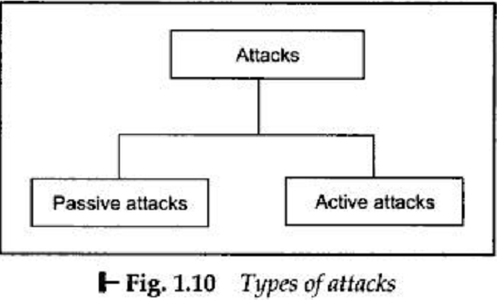
Further Grouped in to types:

Slide 41
Passive Attack
Attacker eavesdropping or monitoring of data transmission.
Tries too learn something out of it & make use of it.
Aims to obtain information that is in transmit.
No Modification
Detection harder.
1. For plain text Message
Solution prevention :- encryption
2. For Encoded Message
Similarity -> Pattern -> Clue

Slide 42
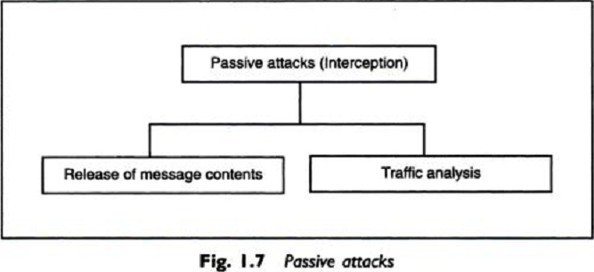
Classification of Passive Attack

Slide 43
Active Attack
Modification
Creation of False Msg
No prevention
Solution Detection & Recovery

Slide 44
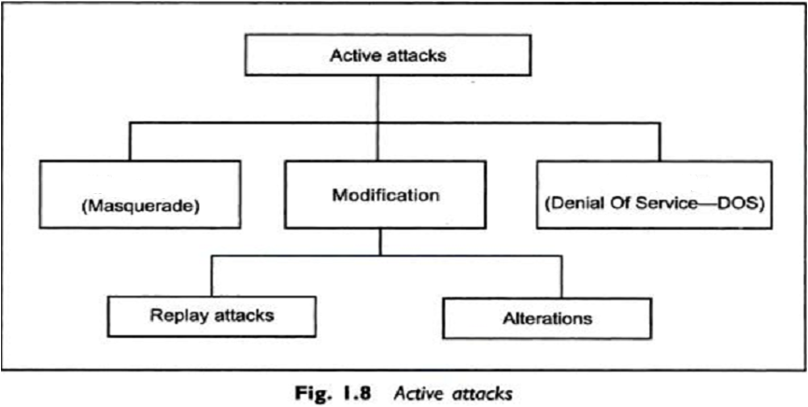
Classification of Active Attack
Masquerade :- Trying to pose as another entity

Slide 45
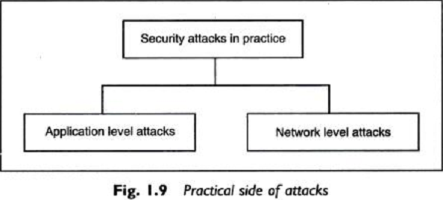
2.Practical Side Of Attack

Slide 46
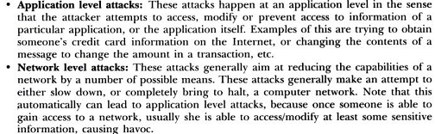

Slide 47
References:
Dr. V.K. Pachghare, Cryptography and Information Security, PHI,ISBN 978-81-303-5082-3
Atul Kahate, Cryptography and Network Security, Tata McGraw Hill,ISBN 978-0-07-064823-4
Further Reading use ppt’s after this slide

Slide 48
Program That Attacks
Virus
Worms
Trojan Horse
Applets & ActiveX Controls
Cookies
Java Script VB Script Jscript
Etc.
Program That Attacks to cause some damage or to create confusion.

Slide 49
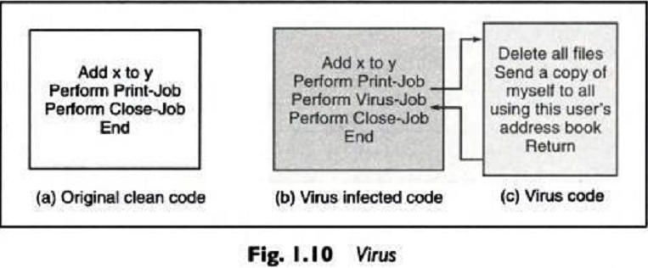
1.virus
Practical Side Of Attack
A piece of program code that attaches itself to another legitimate program & causes damage to the computer system or to the N/W.

Slide 50
1.virus
Properties Of Virus
Self-propagates
Action /Event Driven
Solution->Good backup, recovery Procedure.
During its life time Virus goes through four phases:-
Dormant
Propagation
Triggering
Execution

Slide 51
1.virus
Virus can be classified into following categories:-
Parasitic->.EXE
Memory-Resident Virus->.EXE
Boot Sector->MBR->Disk->OS
Stealth->Intelligence Built in->prevent detection AV
Polymorphic->changing its signature->difficult detection
Metamorphic->5+rewriting itself every time->more hard
Macro virus->Application S/W->like MS office Docs.

